Slide 1
CMAC 3990.200
Systems Administration and Operations
Fall 2025 – Week 6.1 – September 30, 2025
Disaster Recovery, Storage, and Network Virtualization

Slide 2

Objectives
Assignment reviews
Disaster Planning and Recovery
Thin Clients
Network Virtualization
VIP & VLAN Tagging Install
Backups & Rsync
Network File System (NFS)
Common Internet File System (CIFS)
Distributed File Systems (DFS)
Data Storage
Storage Area Network (SAN)
Network Attached Storage (NAS)
NFS Service Installs
Crontab

Slide 3

Weekly Info
Great minds discuss ideas; average minds discuss events; small minds discuss people.
  -Eleanor Roosevelt
Attendance
Good of the class
Midterm Reminder
  2 Weeks – Tuesday October 14, 2025
Presentation Reminder!
  December 2, 2025

Slide 4

Assignment Reviews
Assignment 5 – Due last week!
  AWS Educate – Introduction to the AWS Management Console
Assignment 6 – Due this week!
  Project Proposal
Assignment 7 – Due next week!
  AWS Educate – Introduction to Cloud 101

Slide 5

Disaster Recovery Exercises (DRX)
Planning for disasters
  Loss of staff
    Employee strike?!
    Transportation incident
    Natural Disaster
  Loss of data/infrastructure
    Corruption of data
    Accidental/Intentional deletion of data
    Natural Disaster
      Fire, tornado, flood, etc.
    Man-made disaster
      Plane crash, civil unrest
  External influences
    Critical provider outage
    Natural Disaster

Slide 6
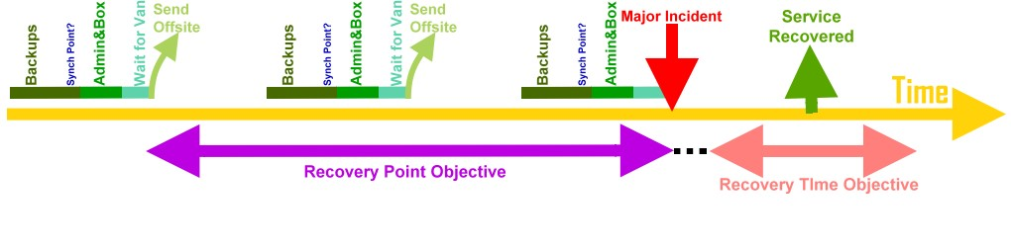
Disaster Planning and Recovery
A Disaster Recovery Plan is a documented process and/or set of procedures to recover and protect a business IT infrastructure in the event of a disaster.
Comprehensive statement of consistent actions to be taken before, during, and after a disaster.
  Unintentional: Meteorite, landslide, hurricane, weather, construction
  Infrastructure failure: Network or power provider unable to provide services
  Intentional: Terrorism, civil unrest

Slide 7
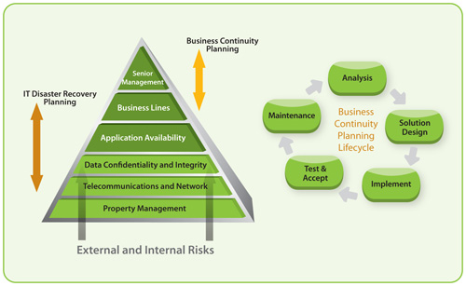
Disaster Planning and Recovery
An insurance plan for Business
  Sense of security
  Minimize risk
  Reduce delays
Tiering of applications
  Infrastructure Tier
  Business Critical Tier
  Lower Business Tiers
For example, of companies that had a major loss of business data, 43% never reopen and 29% close within two years.
Notes:
Business continuity statistics: where myth meets fact. Continuity Central. 24 April 2009. Retrieved 3 August 2012.

Slide 8
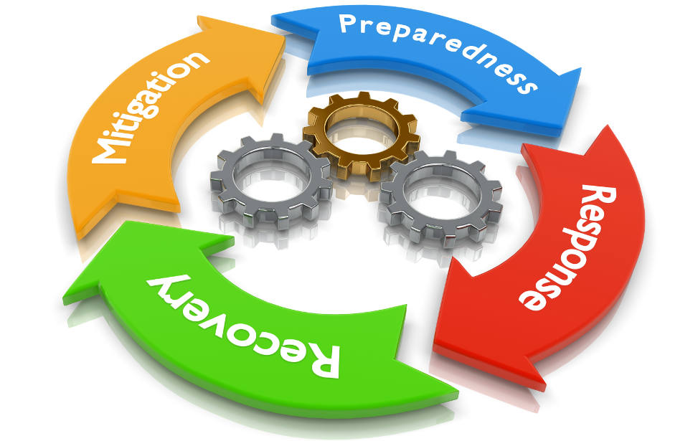
Disaster Planning and Recovery
Perform a risk assessment
  Determine potential consequence of various system disasters
Establish priorities
  Where to allocate resources first
Determine necessary strategies
  Facilities, hardware, software, communication links, data files, customer services
  Hot sites, warm sites, cold sites
Collect Data
  Gain input from multiple business areas
Document a written plan
Develop testing criteria and procedures
Test!

Slide 9

Disaster Planning and Recovery
A disaster recovery plan looks at what disasters could happen, and lays out a plan of recovery.
  Identification of current disaster scenarios
  Implementation of methods to identify potential new disasters
  Planning and preparations to enable service restoration
  Identification of key services, tiering
Define the disaster
  Natural disaster, major catastrophe, stray backhoe
Perform a risk analysis
  Analyze potential risks and the costs associated with each
    cost of disaster * risk of disaster = cost of mitigation
Legal Obligations
  Vendors, customers, shareholders, stakeholders
Notes:
If a company’s premises has 1:1,000,000 chance of flooding, and a flood would cost $10 million, the budget for mitigation is $10.
New Orleans Data Center, 1:1,000 chance of flooding, $100 million cost, mitigation budget is $1,000,000

Slide 10
Disaster Planning and Recovery
Another risk analysis example
  Single point of failure (router), causes many connected networks to go offline
  Estimated repair time is one day
  70% chance of failure every 2 years
  Outage prevents 1,000 people from working that day
  $68,000 estimated loss of productivity
  $23,800 budget for mitigation!
    cost of disaster * risk of disaster = cost of mitigation
Create a restoration plan!
  Who should do it?
  What should be done?
  Where do we do it?
Disaster preparedness!
Notes:
cost of disaster * risk of disaster = cost of mitigation
68,000 * 0.70/2 = 23,8000

Slide 11
Disaster Planning and Recovery
Disaster limitation
  Reducing the cost of disasters
  Advance planning and good processes
  Lightning rods, secured racks, above ground level
  Fix the problem once!
Disaster Preparation
  Preparation means being able to restore essential systems
  in a timely manner
  Rebuilding infrastructure and equipment
  Secondary site for data, work, etc.
    Internet, telephone, video, printing, etc.
  Off-site backups!
  Digital and physical documentation
Security Breach!?
Notes:
Power interruptions are one of the most common disasters to plan for

Slide 12
Disaster Planning and Recovery
Data Integrity
  Ensuring that data is not altered by external sources
    Promote data consistency, prevent data corruption
  Ensuring data can be restored to the systems
    A backup is great, but you also need to recreate the systems
  Industrial espionage
    Theft of intellectual property
Redundant Site
  Fully redundant second site
    Services can be “failed-over” to the second site
    Minimal interruption in services
  Partial redundancy
    Only systems deemed necessary have DR counterparts
    Services are only brought online in testing or in a disaster
Public Relations!?
Notes:
Budget, timeframe, planning

Slide 13
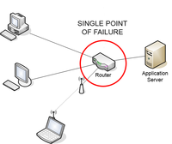
Disaster Planning and Recovery
Fault Tolerance
  The ability of a system to continue operating properly in the event of the failure of one (or more) of its components.
  A fault-tolerant design enables a system to continue its intended operation, possibly at a reduced level, rather than failing completely, when some part of the system fails.
Fault Domain
  A set of hardware components that share a single point of failure.
  Multiple servers connected to the same power feed or network hardware.
Single point of failure
  A part of a system that will stop the entire system from functioning
  upon failure
  Motherboard

Slide 14
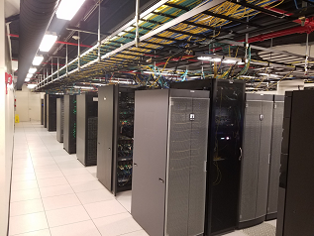
Data Center Quick Info
Rack mountable equipment
Extensive redundancy
  Redundant power, cooling, networks, other devices
Power Distribution Units (PDU’s)
  Can monitor power draw (amperage)
  Some are network accessible
Raised floor design
  Power feeds under floor
  Cooling through floor
Overhead cable trays
  Storage or TCP/IP networks

Slide 15
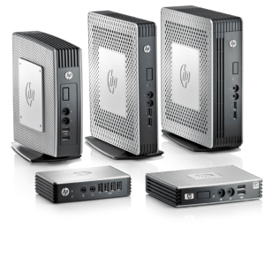
Thin Clients
Small, lightweight, purpose-built computer
  Minimal OS (typically Linux) on device
  Devices can easily be swapped in case of hardware failure
Built for remote server access
  For use within a Virtual Desktop Infrastructure (VDI) environment
  Servers host desktop sessions and provides access to clients
Uses protocols such as RDP or VNC to display a Terminal Server session
  Can also display individual applications
  Single application still runs on servers
Centralizes desktop resources inside the data center
  Rather than managing a large number of desktops, a smaller number
  of servers can be managed

Slide 16
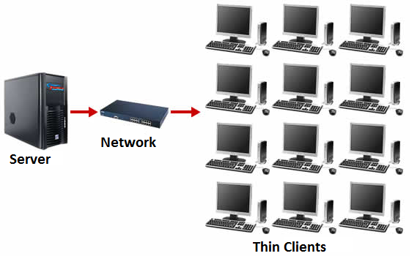
Thin Clients
Reduces maintenance overhead
  Desktop hardware is harder to maintain
  Software licensing is on server instead of workstation
  Centralizes administration
Improves security
  Easier monitoring of access
  Contains sensitive data within data center
  Centralized patch management
Hardware offloading
  Video processing can be done on device instead of server
Improves availability
  Data center redundancy

Slide 17
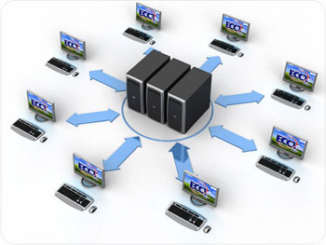
Thin Clients
Lowers costs
  Total cost of ownership (TCO) is lower
    Less expensive hardware
    Less man-hours spent troubleshooting hardware
    Fewer individualized workstations
Easier to maintain
  Less desktop maintenance needed
  Install, configure, maintain applications on a small number of servers
  instead of a large number of desktops
Limitations
  Thin client may lack necessary connectivity for peripheral devices
    Webcams, biometric security devices, printers, scanners
  Limited local storage and processing power

Slide 18
Thin Clients
Variations
  Zero Client
    Even less software, initializing only local hardware
    May download software image to execute from network
    Fewer components, longer time in use
    Even less local machine administration
    Optimized for a specific communication protocol
  TV Client
    Web TV
    Roku, Fire TV, etc.
  Web Client
    Provides services through only a web browser
    Minimal local storage
    Cloud based storage and services
    Chromebooks

Slide 19
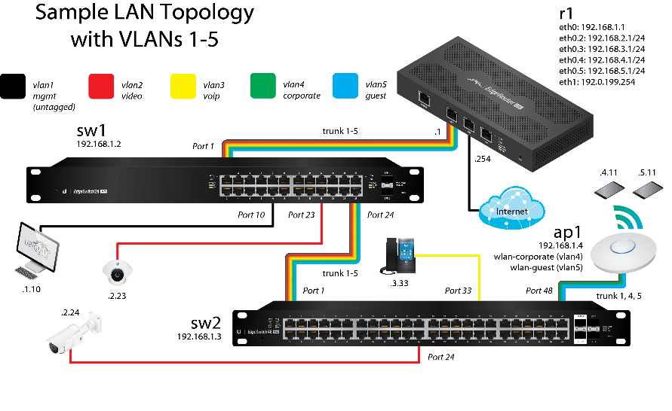
Network Virtualization
“The process of combining hardware and software network resources and network functionality into a single, software-based administrative entity, a virtual network.” – Wikipedia
Allows one physical network to be split into separate logical networks
Subdivides LANs into Virtual Local Area Networks (VLAN)
  VLAN Tagging – 802.1Q
  RFC 2674
Managed switches can set specific switch ports
to be on specific network VLANs
Increases network flexibility while reducing costs
  Additional hardware is no longer needed to create
  a separate network

Slide 20
Network Virtualization
Network trunking allows multiple networks over a single link
  A tree with one trunk and many branches
  Multiple separate networks over a single physical wire
  Reduces physical infrastructure overhead
  A single transmission channel between two points
VLAN Tagging
  Inserting a VLAN ID into a packet header
  Packet is then routed based on VLAN header tag
  Required for VLAN’s spanning multiple switches
  Typically applied at a network switch
  Can also be applied at OS configuration

Slide 21

Network Virtualization
Managed
vs
Unmanaged

Slide 22
Network Virtualization
VIP’s – Virtual Internet Protocol Addresses
  A secondary address that can be added to a current network interface
  Provides for fault tolerance and IP address mobility
  Specified in/etc/NetworkManager/system-connections/ files
VLAN’s – Virtual Local Area Networks
  A group of devices configured to communicate as if they
  were on the same network
  May be spread across different physical networks, shared
  among other networks
    A network within a network
  Specified in/etc/NetworkManager/system-connections/ files

Slide 23
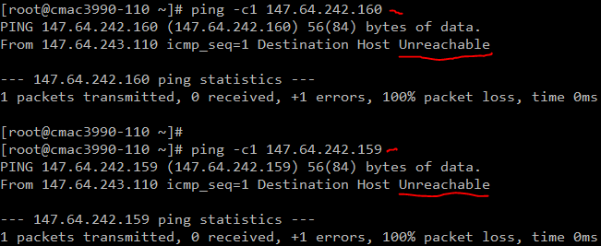

Virtual IP’s
Add a second IP to your bond-mybond0 connection!
  This will be our Virtual IP – VIP!
First, validate we cannot ping our VIP at 147.64.243.150+##: (150-160)
  ping -c1 147.64.243.150+##
Add 150 to your number!

Slide 24
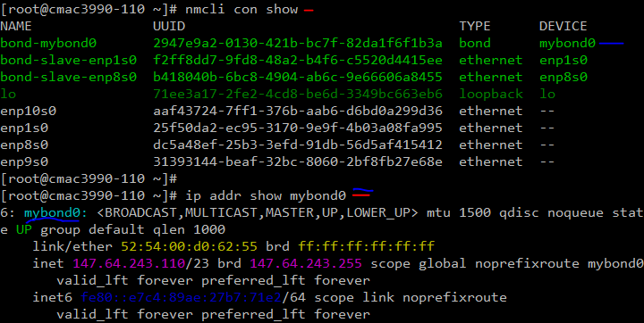
Virtual IP’s
  Second, verify our current device names and ip addresses:
  nmcli con show
  ip addr show
Add 150 to your number!

Slide 25
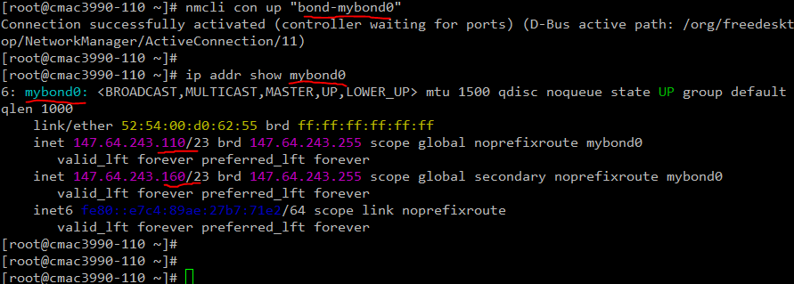
Virtual IP’s
Third, add an additional IP address to your bond interface and restart the interface!
  nmcli connection modify "bond-mybond0" +ipv4.addresses "147.64.243.150+##/23"
  nmcli con up "bond-mybond0"
  If something breaks, you may need to use the OOB VNC connection to fix your configuration!

Slide 26
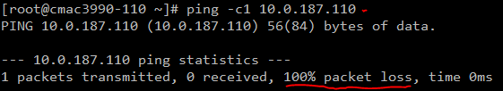

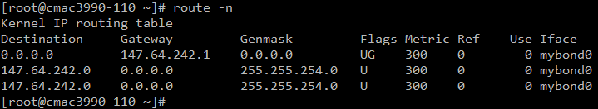
Linux VLAN Tagging
First, let’s validate we cannot ping professor’s machine on VLAN 187 – 10.0.187.110
  ping -c1 10.0.187.110
Next, lets validate our interfaces and routes
  ifconfig (6 interfaces – enp10s0, enp1s0, enp8s0, enp9s0, lo, mybond0)
  route -n (3 routes)

Slide 27
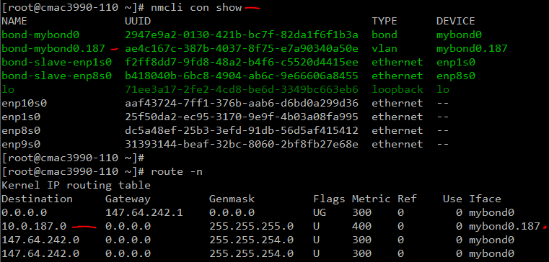
Linux VLAN Tagging
Now, lets add VLAN 187 on device mybond0 and configure an IP address
  nmcli con add type vlan con-name "bond-mybond0.187" dev mybond0 id 187
  nmcli con mod "bond-mybond0.187" ipv4.method manual ipv4.address "10.0.187.1##/24"
  nmcli con up "bond-mybond0.187"
We should now have 6 interfaces, 5 active connections, and 4 routes
  New interface mybond0.187, new connection bond-mybond0.187, new route 10.0.187.0/255.255.255.0

Slide 28
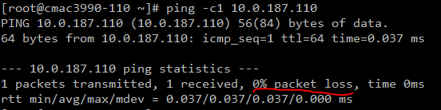
Linux VLAN Tagging
Finally, lets verify that we can ping the machine that we could not before:
  ping -c1 10.0.187.110
  Success!

Slide 29
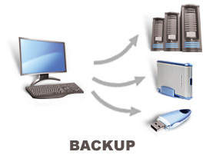
Backups
The process of copying and archiving data so it can be used to restore data in the event of a data loss.
Backups should be kept in a geographically different location from primary data storage.
Testing that your backups work is critical!
Backups can use any type of media.
  Writable discs (CD/DVD) generally have a short lifespan
  Magnetic tapes have a longer life but are restricted by serial access
Multiple backups for redundancy!
  Primary data source, onsite protected backup, offsite protected backup
Backups can be of an entire system, or only specific data.

Slide 30
Backups
Full Backups
  Takes a complete backup of all data at a given point
  System images may be useful for backup, can be more difficult to restore from
Incremental
  Only makes backups of items that changed since last incremental backup
  Full system restore requires restoring a full backup, followed by each incremental
  Synthetic full backups can be created through software
  Weekly full, daily incrementals
Differential
  Only makes backups of items that have changed since last full backup
  Restore requires a full and most recent differential backup
  Weekly full, daily differentials
  Most common type of backups

Slide 31
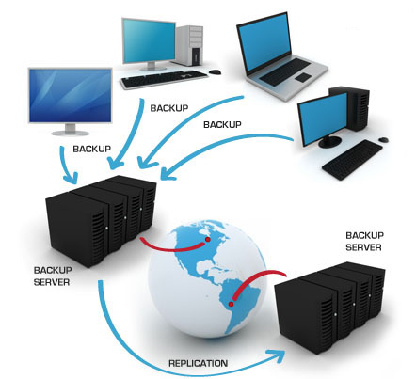
Backups
Continuous Backups
  Changes on a primary system are immediately logged and propagated to backup system
  Typically works on byte/block level, instead of file level
Snapshot Backups
  Systems create a snapshot, which is presented as a copy of the
  original, which can then be backed up
  Services can be quiesced before snapshot, releasing any file locks
  Snapshots create a “crash-consistent” state
  Backups can then be taken of the snapshot
Hot and Cold backups
  Hot backups can make a backup while systems are online
  Cold backups require data files to be closed
  during backup to prevent change

Slide 32
Backups
Compression
  Shrink the size of source data so more data can fit on destination device
  Typically will decrease overall backup speed
  Extra burden on compression hardware
Deduplication
  Reduce amount of data stored, by only storing a single copy and saving deduplication metadata
  Can be de-duped on source or target
  Can potentially increase speed
  Extra burden on deduplication hardware
Encryption
  Backup media is encrypted, minimizing risk if lost
  Typically decreases overall backup speed
  Additional burden on encryption hardware

Slide 33
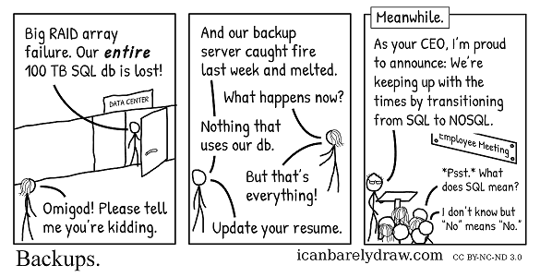
Backups
Backups are a crucial part of any information system
Data may be inadvertently deleted, a RAID array will happily delete all of that data!
RAID ARRAYS ARE NOT BACKUPS!!!
Backups are like insurance – you pay for it but you hope to never need it!
Backups should be maintained and monitored
  Failed backups should be investigated and corrected
Backups should be kept off-site
  Having your backups in the same location as your
  primary data storage location is a bad idea!
Test your backups!
  If you can’t restore a backup, it is useless!

Slide 34
Backups
Guidelines for backups should dictate minimum recovery times and data expiration timelines
Policies should put the guidelines into a document that can then be turned in to a backup system
Procedures should detail how backups are performed,
what is done with backup media, etc.
Schedules should be made to detail what specific backups
are performed when
  Having all your backups run at the same time is a bad idea!
  The policy translated into a software configuration
A business/regulatory/government specification may dictate
how many backups are necessary and how long they are kept
Disk failure may be mitigated by a RAID array
  Multiple disk failures within a single array can be catastrophic!

Slide 35
Backups
Backups should be automated!
  A backup administrator should optimally only monitor the system
  and make adjustments to any policies and procedures
    Might be necessary to gather backup media for off-site transport
  Backup drives should automatically rotate if possible
    Automated tape libraries can rotate backup tapes
  Automation eliminates the potential of human error
    Command automation
    Schedule automation
    Media rotation automation
    Fire-drill automation
  Backup fire-drills – Test the restoration of data from a backup!
    A backup is useless if it can’t be restored!
    How about automated backup fire drills?!

Slide 36
CMAC 3990.200
Systems Administration and Operations
Fall 2025 – Week 6.2 – October 2nd, 2025
Some San, Some NAS, Some Backups, and some more…

Slide 37

Rsync
A utility for efficiently transferring and synchronizing files
Checks timestamps, file sizes, or hashes (MD5, etc)
Used delta encoding to synchronize files, transferring differences instead of entire files
Can optionally use compression when transferring files
Can be used for local or remote synchronization
Rsync Parameters:
  -a : Archive mode (recursive, copy symlinks, preserve permissions, preserve timestamps,
  preserve user/group ownership)
  -v : Verbose – Display a list of what is being copied
  -z : Compress data during transfer
  --delete : delete files in destination that are not in the source
  --exclude : Exclude a specific item from being synchronized
  Many more options in the man pages!

Slide 38
Rsync
Examples:
  rsync -avz /local/folder server:/remote/place/
    Note the trailing slashes! They are important to determine what is sync’d!
    “/local/folder” is created inside of “/remote/place/”
    In this example, the entire contents of “/local/folder/” is synchronized inside “/remote/place/folder/”
  rsync -avz /local/folder/ server:/remote/place/
    Note that in this example, the items within “/local/folder” are synced inside “/remote/place/”
  rsync -avz --delete --exclude 'folder' /source/data/ server:/destination/data/
    Sync local files within “/source/data/” to remote server within folder “/destination/data/”
    Exclude the folder named ‘folder’ from being synchronized
  rsync -avz --delete /etc /backups/
    Sync entire local “/etc” folder within “/backups/” folder
      A sub folder “/backups/etc” will be created on the target, and the contents will be synced within!
      The trailing slashes are important!!!
      Test within subfolders if you are not sure!

Slide 39
Rsync
Some simple rsync backups!
  Install rsync!
    dnf install rsync
  Create a local /backup folder
    mkdir /backups
  Use rsync to recursively and verbosely backup your /etc folder, deleting anything at the target that does not exist on the source. Preserve timestamps, permissions, and ownership of all files and folders
    rsync -av --delete /etc /backups/
  Check the backups folder to verify!
    [root@server1 ~]# ls -lh /backups
    total 12K
    drwxr-xr-x. 84 root root 8.0K Sep 30 10:21 etc
  Check within the /backups/etc folder!
    ls -lh /backups/etc

Slide 40
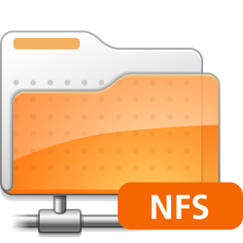
Network File Systems (NFS)
Network File Systems are a way of sharing files and applications across the network.
  Native to Linux/Unix systems
  Comparable to Windows file sharing
  Client/Server model
    Clients mount remote file systems from a server
  Remote Procedure Calls (RPCs) handle the requests between the client and server
Usages
  Shared drives (like a mapped P:\ drive in Windows)
  Home profile folders on a server instead of a local machine
    Redundancy, backups, maintenance at a server level instead of a desktop level
  Auto-mounting
  Hosting programs

Slide 41
Network File Systems (NFS)
Versions of NFS
  NFS v1 – Initial internal development version by Sun Microsystems, experimental
  NFS v2 – First public release
    RFC 1094 – March 1989
    2GB file size limit (32-bit)
    Stateless (UDP), with file locking implemented outside of NFS core protocol
      Vendors had added stateful (TCP) transport support separately
    Requires additional RPC port mapping, locking, and binding services
  NFS v3 – Major upgrade in features and security fixes
    RFC 1813 – June 1995
    Supports files larger than 2GB (64-bit)
    Support for asynchronous writes, improving write performance
    Officially added stateful (TCP) communication

Slide 42
Network File Systems (NFS)
Versions of NFS
  NFS v4 – Additional performance improvements, mandated security, new stateful protocol
    RFC’s: 3010 – December 2000, 3530 – April 2003, 7530 – March 2015
    Can use TCP or Stream Control Transmission Protocol (SCTP) for transport
    Supports per-user authentication
    Port mapping, locking, and binding functionality built in
    Supports Access Control Lists (ACLs)
  NFS v4.1 – Additional features
    RFC 5661 – January 2010
    Clustered server support, parallel access to distributed systems
  NFS v4.2 – Latest!
    The IETF published NFS 4.2 as RFC-7862 in 2016
    Still improving!

Slide 43
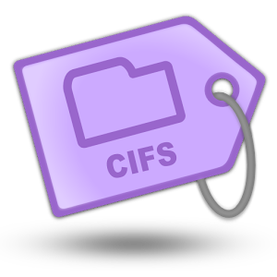
Common Internet File System (CIFS)
Also often referred to as SMB
Used for sharing files on Windows
Can be accessed from Linux/Unix clients using Samba
Samba 3.7 introduced SMB2 support
  SMB2 introduced with Windows Vista (2006)
Samba version 3 can act as a NT4 domain controller
  Primary or backup domain member
Samba 4 enables Active Directory domain controller functionality
  Windows 2008 domain functionality
  Samba 4.1 adds support for SMB3
  SMB3 introduced with Windows 8 (2012)

Slide 44
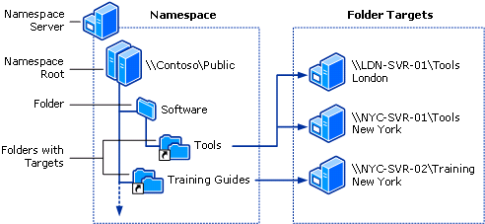
Distributed File Systems (DFS)
A Distributed File System makes it possible to create a single directory tree that links together multiple file servers and their files
Provides a common view of a centralized file system that is distributed among various servers
  Even though files are stored on different servers, to the user they appear on the same server
  Allows for replication among DFS servers
  Allows for the movement of files physical
  storage location without affecting any
  user or application usage
  System can be reconfigured as needed
  to alleviate performance issues
  System can be easily expanded if necessary,
  without any impact to existing users

Slide 45
Distributed File Systems (DFS)
DFS provides access to a shared directory structure with no files, only junctions
  Junction points are similar to shortcuts or soft links
Junctions can point to other junctions or shared directories on various servers
Creates a user-friendly name space of directory structure, abstracted from server names
A DFS name can point to more multiple targets
  Provides load balancing and automatic failover
DFS provides several desirable functions
  Alternative name space
  Load balancing
  Automatic failover

Slide 46
Distributed File Systems (DFS)
Distributed file systems prevent multiple people from updating the same file
  Files are locked when in use, preventing simultaneous modifications
Servers maintain replications and share file changes
  If a file is replicated between multiple nodes, the
  updates are replicated between nodes
Adds another layer of redundancy
  Replicated services can continue to function
  in the case of a system crash
NFS devices typically employ some type of
distributed file system

Slide 47
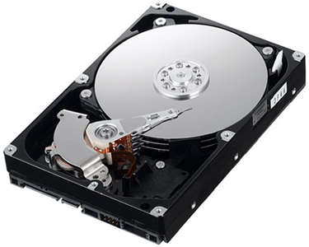
Data Storage
Terminology
  Platter – Magnetic disks where data is stored
  Spindle – Center of platters, where platters are mounted
    Sometimes, the combination of platters and spindle is referred to as the spindle
  Track – A circle on a platter, where data is written
    Tracks near the outside of the platter are longer/larger than tracks near the center
    Each track is located at a different radius (distance) from the center
  Cylinder – All the tracks at a given radius on all platters
    A track is on a single platter. That same track on all platters is a cylinder
  Sectors – A specific section on a track
    Also called blocks
    Different tracks have a different number of sectors depending on the size of the track
      Tracks furthest from the center have more sectors than tracks closer to the center
    Different sector/block sizes can be established when formatting/partitioning a disk

Slide 48
Data Storage
Terminology
  Heads – Robotic arms that hover over platters and move to the appropriate tracks
    Heads read and write the data in the tracks
    Heads are typically mounted together and move as one
    Heads can read from the same track on multiple platters at once (cylinder)
      This can improve read and write time, allowing data to be read from or written to
      multiple platters at the same time
    Actuator arms have the heads at the tip
  Seek time – The amount of time it takes to move the heads to
  the correct position on the platter
  Drive Controller – The electronics within the drive that implement
  the drive protocol (SCSI/ATA/SATA/etc)
    Communicates with the host
    Standards compliance!
    Additional features?!

Slide 49
Data Storage
Terminology
  Host Bus Adapter (HBA) – Manages the communication between the disk drive and the host
    Located within the host
    Typically built in to the motherboard, may use standalone cards for improved performance
    Smart HBA’s exist, which can add performance enhancements
  Older disks may have jumpers for configuration
    Primary and Secondary disks
  Disks can be connected with differing cables depending on the interface
    Serial ATA, Parallel ATA, SCSI
  Disks are typically sealed, to prevent dust
    May have filtered holes in casing to allow pressure equalization
  Crashing Heads – The term for when the heads hit the platters
    Typically results in a dead disk drive!
    Can be a result of vibration or disk movement while powered on

Slide 50
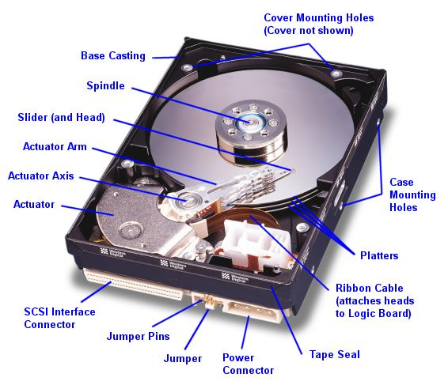
Data Storage

Slide 51
Data Storage
Terminology
  Redundant Array of Independent Disks (RAID)
    Describes a category of techniques that use multiple independent disks to
    provide storage that is larger, more reliable, or faster than a single drive
    RAID Stripe – A group of data split among different disks
    RAID 0 – Block level disk Striping
      Data is spread amongst multiple disks, while still appearing as a single disk
      No fault tolerance or redundancy! If one drive in a RAID 0 array fails, all data is lost!
      Increased read and write speed with more disks
      Increased failure risk with more disks
    RAID 1 – Disk mirroring
      Data is duplicated among multiple disks
      Additional disks provide additional redundancy, as long as one drive in the
      array is operational, the data will remain intact
      Increased read speed, as data can be read from multiple disks at the same time
      Writes are as slow as the slowest drive in the array
Raid 0 provides zero redundancy!

Slide 52
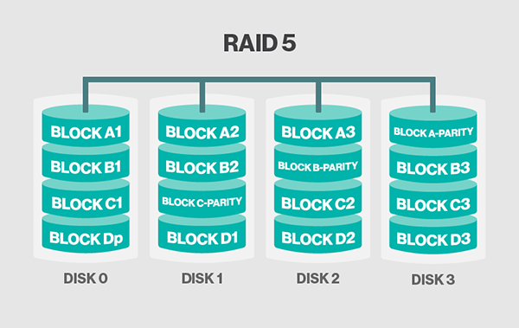
Data Storage
Terminology
  Redundant Array of Independent Disks (RAID)
    RAID 2 – Bit level disk striping
      Similar to RAID 5
      Provides additional parity disk for redundancy and external code for error correction
      Rarely used in practice
    RAID 3 – Byte level striping with parity
      Dedicated parity disk
    Raid 4 – Block level striping with parity
      Dedicated parity disk
    RAID 5 – Block level striping with distributed parity
      Similar to RAID 0 striping, with an additional distributed parity disk
      RAID 5 can continue to operate in a degraded state, when one disk in the array dies
      Provides increased read speed
      Write speed can be reduced, as the additional recovery information is read and written

Slide 53
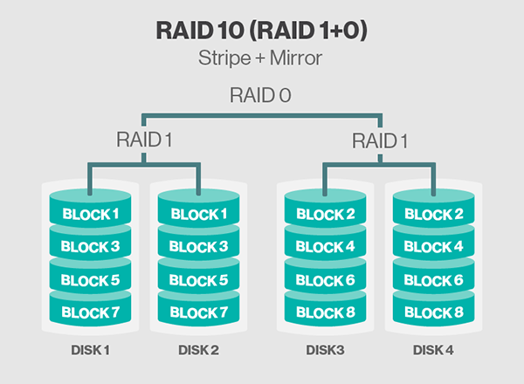
Data Storage
Terminology
  Redundant Array of Independent Disks (RAID)
    RAID 6 – Double distributed parity
      Same as RAID 5, with 2 parity disks
      RAID 6 can continue to operate when two disks in the array die
    RAID 10
      Two separate RAID 1 mirror arrays, nested within a RAID 0 striped array
      Typically one of the best RAID levels for performance and redundancy
      Best performance/redundancy/price combination
    Different RAID levels provide different advantages
      RAID 3 – Good for sequential reads (video, streaming)
      RAID 4 – Good for some NAS filesystems (WAFL)
      RAID 5/6 – Increased reliability and performance
      RAID 10 – Typically best performance and reliability
    Vendor specific RAID-type of setups
      Proprietary code that creates something similar to a RAID array

Slide 54
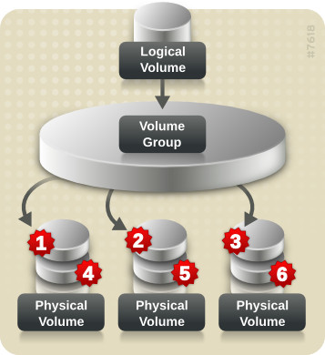
Data Storage
Terminology
  Volumes – A chunk of storage as seen by the server
    Originally, a volume was a disk, and every disk was one volume
    Partitioning and RAID allowed for disks to be split or combined into volumes
    A server sees a volume as one logical disk
  Volume groups – A group of volumes!
    Can combine separate physical volumes into one single volume
    Combine separate disks, or separate RAID arrays
  Filesystem – The method and structure of data storage on a volume
    Many different file systems available, each with different benefits and drawbacks
    Some filesystems provide journaling, or keeping a list of requested filesystem changes
    and applying the changes in a batch process
      Journaling typically provides better write speed and recovery after a crash
  Cache Disk – A high speed disk that caches the data
    Improves performance

Slide 55
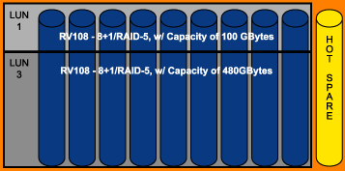
Data Storage
Terminology
  Hot Spare – An extra disk that can automatically be placed into service when another disk dies
  Direct Attached Storage (DAS)
    Storage that is attached directly to the server rather than through a network
  Storage Area Network (SAN)
    A dedicated network of disk subsystems that connect servers to storage
      Optimized for high speed and low latency using storage protocols
    Disk segments are separated into LUNs that define what server can access what storage
  Logical Unit Numbers (LUNs)
    An number used to identify a logical unit
    A logical unit is an area of storage within the SAN
      A piece of the larger RAID array, presented as an independent disk
    Often referred to as a disk by storage admins
  IOPS – Input/Output Operations per second

Slide 56
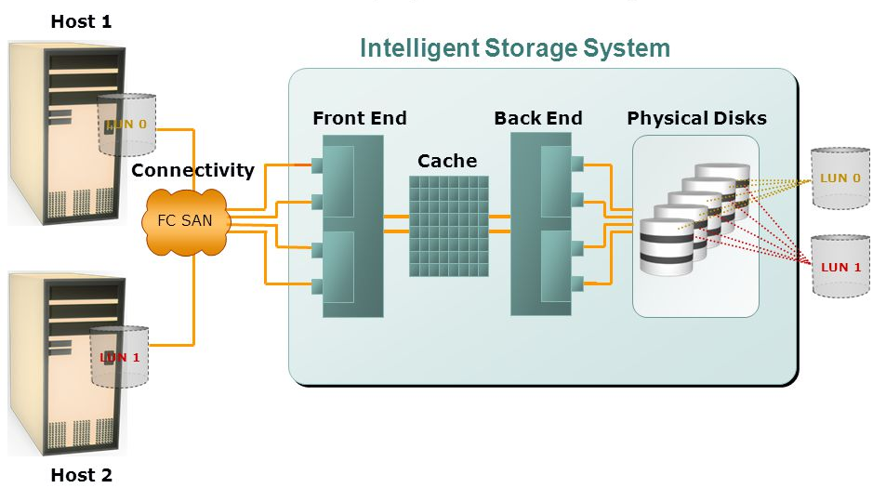
Data Storage

Slide 57
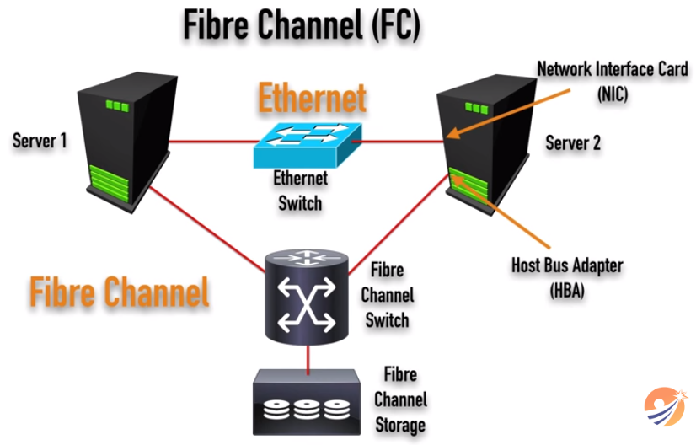
Data Storage
Intro to Storage Area Network (SAN) Technologies
  https://www.youtube.com/watch?v=4RsLUTJ_Qtk
    5 minutes 17 seconds

Slide 58
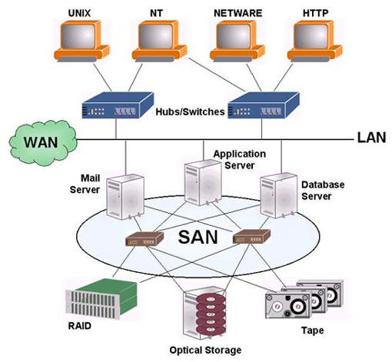
Storage Area Networks (SAN)
A network with provides access to consolidated block level data
  Devices appear to a server as a locally attached device
    Think C:\ drives
  SAN devices could be disk arrays (RAID or similar),
  tape libraries, optical storage arrays, etc.
  Uses a separate network that is not accessible
  through the traditional LAN (usually)
    SAN networks can be created over a traditional TCP/IP network
    SAN networks require high speed and low latency for optimal operation
  Can use Fiber Channel, iSCSI, ATA over Ethernet, and HyperSCSI
    Also Fiber Channel over Ethernet (FCoE)
Consolidate all servers local disks (C:\ drives) into a highly
redundant appliance
  Allows for data replication, de-duplication, better use of storage

Slide 59
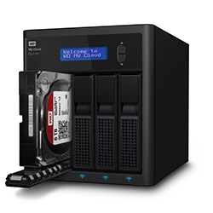
Network Attached Storage (NAS)
A file-level data storage server connected to a computer network
  Provides data access to clients
  Specialized for service files
  Combination of server hardware, software, and disk drives
  Provides access using NFS, CIFS, or Apple Filing Protocol (AFP) on Macs
Built-in redundancy, RAID, error-checking, etc.
Allows for centralized file management and redundancy within the data center
  Backups
  Redundant power, disk drives, network connections
  Allows for clustering, mirroring, and advanced protection features
Basically, a server with a bunch of disks serving files over the network
  Provides both a storage system and a file system!

Slide 60
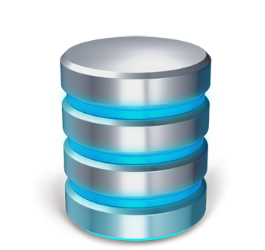
Storage Monitoring
Monitoring is an important aspect of any system, especially storage
  Disk failures – If a disk in your array dies, you need to know!
    Replace bad disks in a timely manner, before additional failures occur!
  Disk outages – Other types of outages that prevent disk access
  Used space and free space – How much space is used, how much is available?
    If a disk runs out of space, bad things may happen!
  Rate of change – How often data is changing? Hot, warm, and cold data.
  I/O usage – How many IOPS are happening on a storage pool
  Network Interfaces – Available bandwidth for FC or Ethernet connections
    Is the network connection saturated? Might be time to add some more!
  File system operations – Bad calls to the storage system?
    Storage system policies can create overhead
  Lack of usage – is a typically busy storage system idle? Why?

Slide 61
Storage Performance
Some typical guidelines for performance
  Never hit the network if you can stay on disk
  Optimize your storage array for the application
  Set your RAID stripe size to the block size
    One stripe then uses one block per disk
  Increase the disks in your storage pool
    More spindles means more speed
  Use fast hard disks
    15,000, 10,000, 7,200, 5,400 RPM
    6Gb/s vs 3Gb/s, etc.
  Use a cache disk
    High speed cache disks makes often use data available faster than pulling from the array
  Consider SSD drives where possible
    Expensive compared to traditional spinning disks

Slide 62
Network File Systems (NFS) Client Install
Mapping a NFS share to a local mount point
  Install NFS Client tools (should already be installed)
    dnf install nfs-utils
  Create the local folder to mount at
    mkdir -p /home/students
  Add network mount to filesystem configuration file /etc/fstab
    147.64.243.110:/home/students /home/students nfs rw,sync,hard,intr,bg 0 0
  Reload systemctl and mount any missing filesystems from /etc/fstab file
    systemctl daemon-reload; mount -a
  Check that filesystem has been mounted
    df –h /home/students
      147.64.243.110:/home/students 20G 175M 20G 1% /home/students
  Manually unmount and remount network file system
    umount /home/students
    mount 147.64.243.110:/home/students /home/students
Notice the bg option!

Slide 63
Network File Systems (NFS) Server Install
Exporting a NFS share as a server to a client
  Install NFS Client tools (should already be installed)
    dnf install nfs-utils
  Start and enable the NFS server service
    systemctl start nfs-server
    systemctl enable nfs-server
    systemctl status nfs-server
  Allow NFS connections through the firewall
    firewall-cmd --permanent --zone=public --add-service=nfs
    firewall-cmd --reload
  Create a new directory to share
    mkdir /nfs-share
  Create a file in our shared directory
    echo Hello > /nfs-share/file

Slide 64
Network File Systems (NFS) Server Install
Exporting a NFS share as a server to a client (continued)
  Export new folder to specified clients
    Edit the file /etc/exports
      /nfs-share 147.64.242.0/23(rw,sync,root_squash)
  Restart the NFS server to apply the new export settings
    systemctl restart nfs-server
At this point, we should be able to mount the share from another machine in the specified subnet
  Only root can mount! See if you can mount from your own machine!
    Mount our shared folder
      mount 147.64.243.1##:/nfs-share /mnt
        Replace the ## above with your 2-digit number!
    Validate!
      ls /mnt
      df –h
      showmount –e

Slide 65
Cron
A time-based job scheduler in Unix-like computer operating systems, used to schedule jobs to run periodically at fixed times, dates, or intervals.
Can run tasks every minute, hour, day, or at a specific
Crontab edited with the crontab -e command
  Crontab editor will be your default editor! Most likely vi.
  Change your cron editor to use joe: export VISUAL=joe
If both day of month and day of week are specified, it is OR! Otherwise it is AND!
Crontab format:
    # Minute Hour Day of Month Month Day of Week Command
    # (0-59) (0-23) (1-31) (1-12 or Jan-Dec) (0-6 or Sun-Sat)
    0 0 * * * /root/script.sh

Slide 66
Backup Script & Cron Job Example
Script – /root/backups.sh:
#!/bin/bash
rsync -avz --delete --exclude "empty" /var /backups/
Don’t forget to set the script executable!
chmod +x /root/backups.sh
Cron – Run nightly at 2:00AM:
0 2 * * * /root/backups.sh

Slide 67
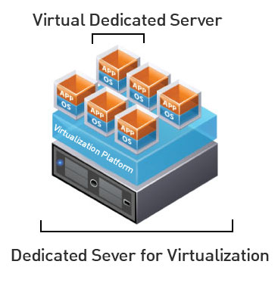
Virtual Machines
VM Info:
  IP Address: 147.64.243.1## (01-10)
  Hostname: cmac3990-1##.cs.edinboro.edu (01-10)
  Alias: 41##.megastuff.biz (01-10)
  Samba: \\147.64.243.1##\ (01-10)
  Additional IP’s
    mybond0 VIP – 147.64.243.150+## (150-160)
    mybond0.187 VLAN – 10.0.187.1## (100-110)
Assignment 6 – Due this week!
Assignment 7 – Due next week!
Assignment 8 – Due in 2 weeks?
  NTP? NFS? BOND? VLAN? VIP? Backups?
  Check script?

Slide 68
Linux Commands
ping
ifconfig
route
systemctl
dnf
mkdir
mount/umount
firewall-cmd
echo
ls
df
showmount
File locations:
/etc/sysconfig/network-scripts/
/etc/fstab

Slide 69

Key Terms and Items
Disaster Recovery Exercises (DRX)
  Causes
  Plans
  Tiering
Fault tolerance
Fault domain
Single point of failure
Thin clients
  Benefits
  Limitations
  Variations
Network virtualization
  Trunks
  VLANs
  Benefits
NFS
CIFS
NAS
SAN
PDU
Data center designs

Slide 70

For Next Week
“We need to hire more people, so we have more feet to shoot” – Unknown…
Textbook:
  Chapter 20: Storage
  Chapter 21: NFS
  Chapter 22: SMB
Next week topics
  SAN, DFS
  Midterm review
Continuing work with VM’s
  System Check and review

